Slide 1
Design specification
Author: Anouchka MINKOUE OBAME - minkoueobamea@gmail.com - Tel:+33 6 58 89 85 31

Slide 2
goals
Goals
1- The idea of ​​design is to show that the user can buy in several stores and pay only once at the end.
2- User can chat in a community of other users.
In the community, he can tchat,
create groups, post events ..
3- Users can post classifieds of sales between individuals.

Slide 3
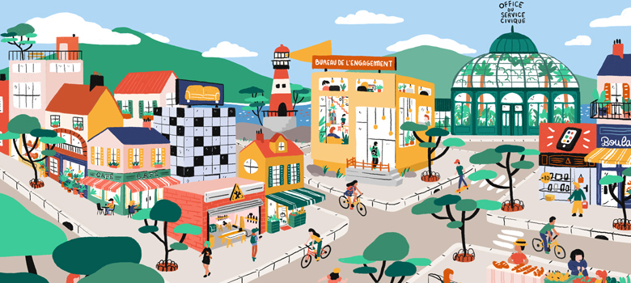

Screen 0
Screen 0-1
Screen 0-2
Gagnez du temps dans vos courses
Achetez près de chez vous
Où que vous soyez, achetez en une seule fois dans plusieurs magasins de votre choix.
Achetez chez vos commerçants locaux

Slide 4



Screen 0
Screen 0-3
Screen 0-4
Screen 0-5
J’aime mes amis, je reste en contact avec eux
Trouvez votre job rapidement
Trouvez des bons plans
Sur le réseau social, discutez et partagez avec vos amis
Trouvez votre job à travers les annonces d’emploi publiées sur ToutPaie
Publiez et trouvez des petites annonces gratuites entre particuliers

Slide 8


Slide 10

Screen 1
Background color of button is: #FD3C12
Put image on background of screen.
When user click on “Se connecter”, screen 2 appears.
minkoueobamea@gmail.com
**********************
Sélectionnez votre département
Connexion
Mot de passe oublié
Inscription

Slide 11
Screen inscription
Background color of button is: #FD3C12
Put image on background of screen.
Formulaire d’inscription
Votre pseudo
minkoueobamea@gmail.com
mot de passe
confirmez votre mot de passe
Inscription
Connexion

Slide 12
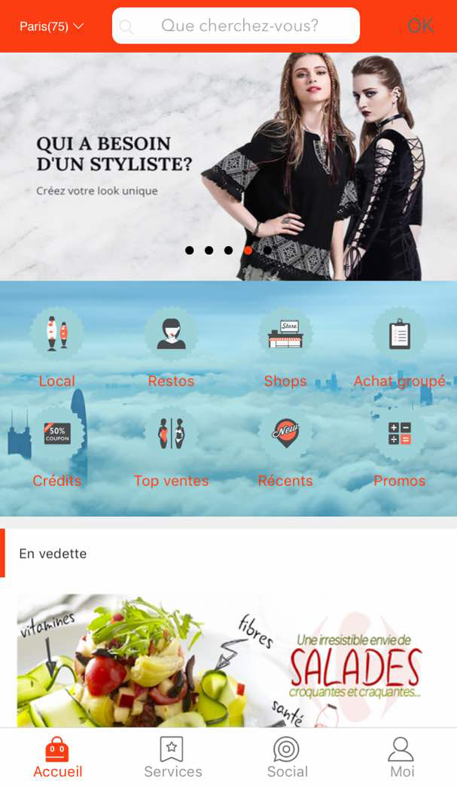
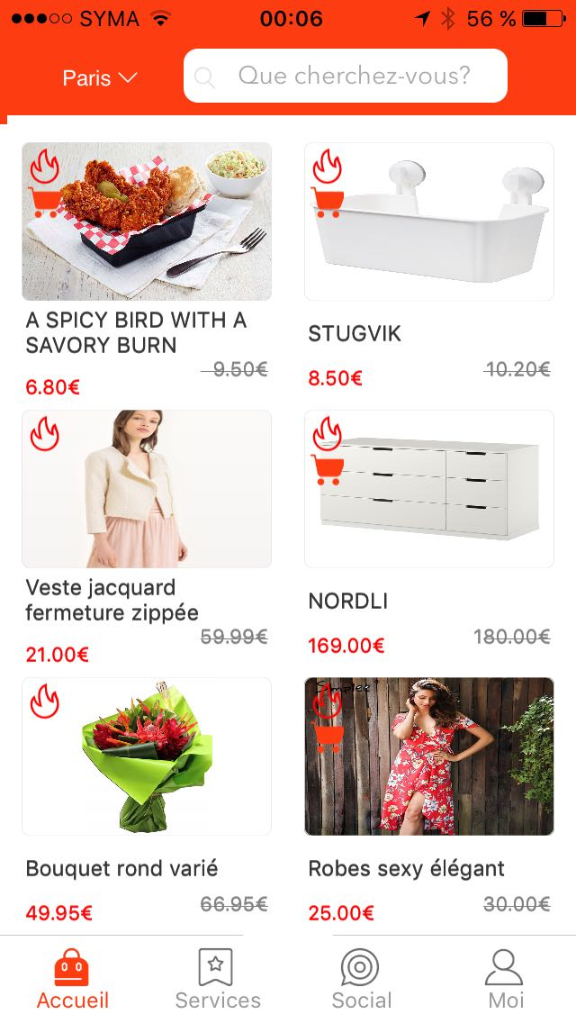
Screen 2
Photo background with a link to a store(pub)
Mode
ITech
Shops
Electro
Restos
Épiceries
Bio
Ventes flash
photo 1
photo 1
photo 1
photo 1
19 €
59€
56 €
150€
19 €
59€
19 €
59€

Slide 13
Screen 2
On screen 2, user can scroll to see these 2 screen.
When user click on “Restos”, screen 3 appears.
Photo background with a link to a store(pub)

Slide 14
Screen 2
It is a search engine that can find stores and products sold in stores.
It is a drop-down list of the different departments of France.
Important:When the user connects, he connects by department, he has access to information by department.In development, the default connection department will be "Seine-Maritime(76)". And there will be 2 departments "Seine-Maritime (76)" and "Paris (75)"
8 photos that scroll horizontally. Put link on photos. You have to put the links on the pictures. Either links to store screens or url links to web pages
Important: The links of the web pages must open in the application.
Mode
ITech
Shops
Main menu. Put this menu block on a white background.
Restos==>Screen 3
Shops ==>Screen 3 but list all the stores of the application located in the department where the user is logged in.
Mode, ITech, Electro, Epiceries, Bio ⇒ Screen 3
Local ==>Screen 3 but list all the stores of the application located within a radius of 3 kilometers. And stores must be sorted in ascending order of distance.
Electro
Restos
Épiceries
Bio
Ventes flash
Ventes flash
photo 1
photo 1
photo 1
photo 1
19 €
59€
56 €
150€
19 €
59€
19 €
59€

Slide 15
Screen 2
Main menu. Put this menu block on a white background.
Restos==>Screen 3
Shops ==>Screen 3 but list all the stores of the application located in the department where the user is logged in.
Local ==>Screen 3 but list all the stores and restaurants, fast-food... of the application located within a radius of 100 meters.
Mode
ITech
Shops
Electro
Restos
Épiceries
Bio
Ventes flash
photo 1
photo 1
photo 1
photo 1
19 €
59€
56 €
150€
19 €
59€
19 €
59€

Slide 16
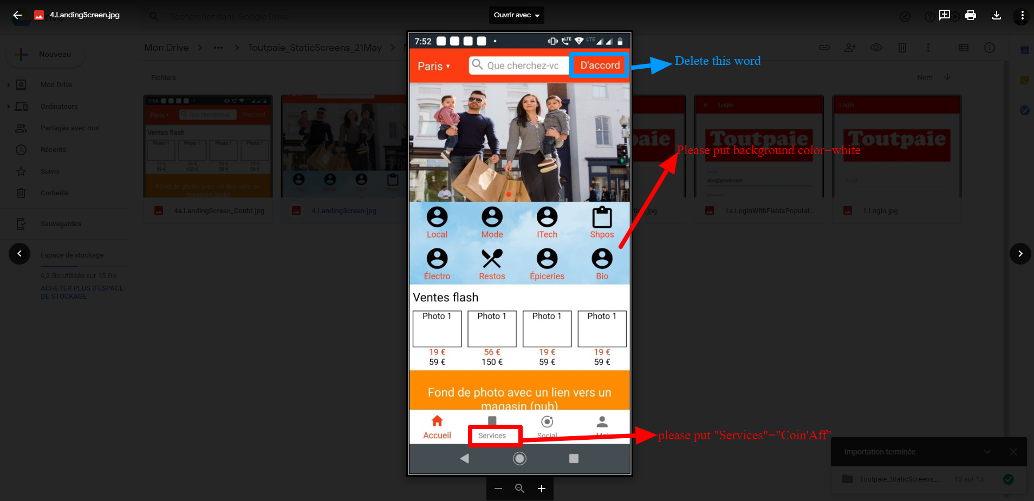
Screen 2
Main menu. Put this menu block on a white background.
Restos==>Screen 3
Shops ==>Screen 3 but list all the stores of the application located in the department where the user is logged in.
Local ==>Screen 3 but list all the stores and restaurants, fast-food... of the application located within a radius of 100 meters.
Mode
ITech
Shops
Voyages
Restos
Épiceries
Bio
Ventes flash
photo 1
photo 1
photo 1
photo 1
19 €
59€
56 €
150€
19 €
59€
19 €
59€

Slide 17
Screen 2
These photos are product images of the stores that make promotions / sales / discounts.
On each photo, put a link to the store that sells this product.
icon with a cart => sales with free shipping(do not do)
icon without a cart => sales without free shipping(do not do)
Accueil==>Screen 1
Services==>Screen “Ads between individuals”
Social==>Screens community social network
Moi==>Screen 5

Slide 18
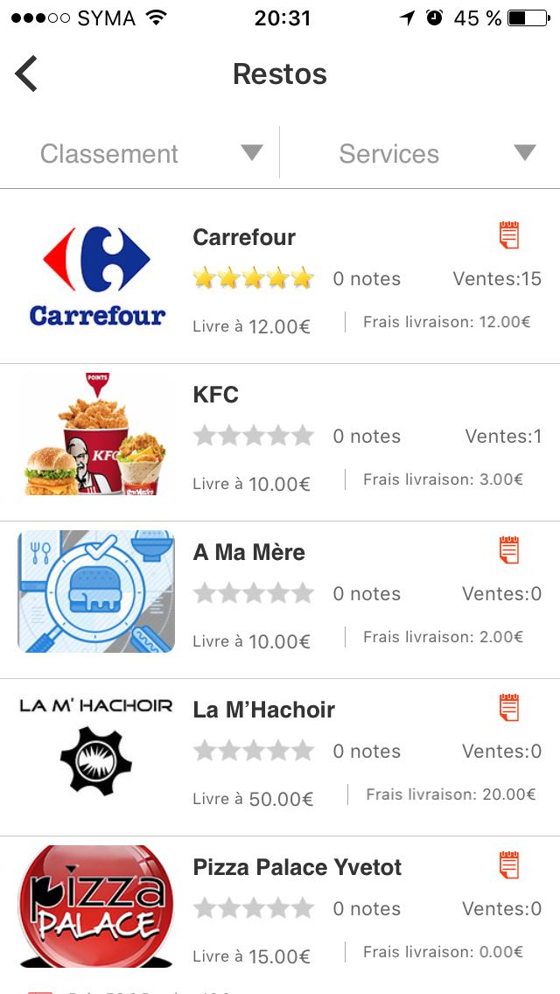
Screen 3(For ‘Restos’)
Rechercher…...
list all the restaurants of the application located in the department where the user is logged in.
When user click on “Pizza Palace Yvetot”, screen 4 appears.
Search engine based on store name, product name ...

Slide 19
Screen 3(For ‘Local’)
Local
Rechercher…...
300 m
Local ==>Screen 3 but list all the stores of the application located within a radius of 3 kilometers. And stores must be sorted in ascending order of distance.
500 m
800 m
1.5 km
2 km

Slide 20
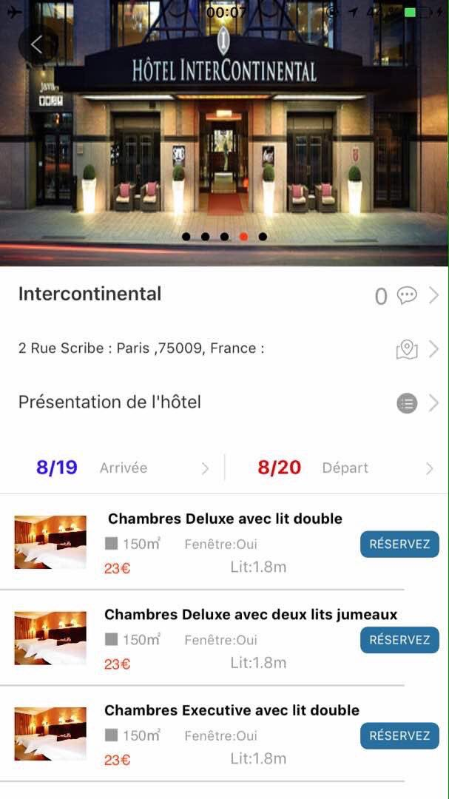
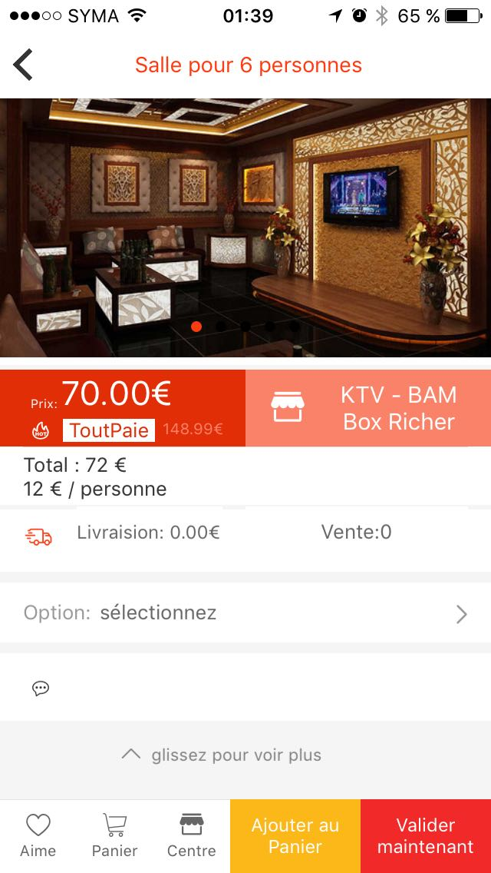
Screen 3(For ‘Hôtels’)
Hôtels
Arrivé
Départ
Search engine based on hotel name ...

Slide 21
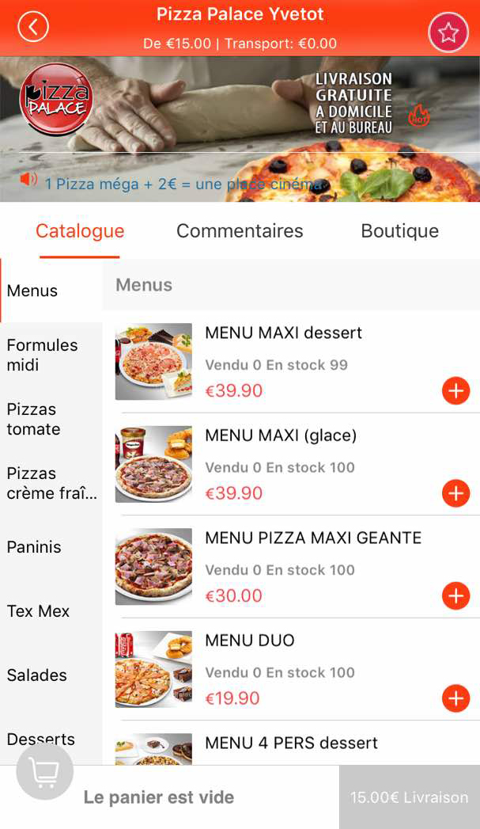
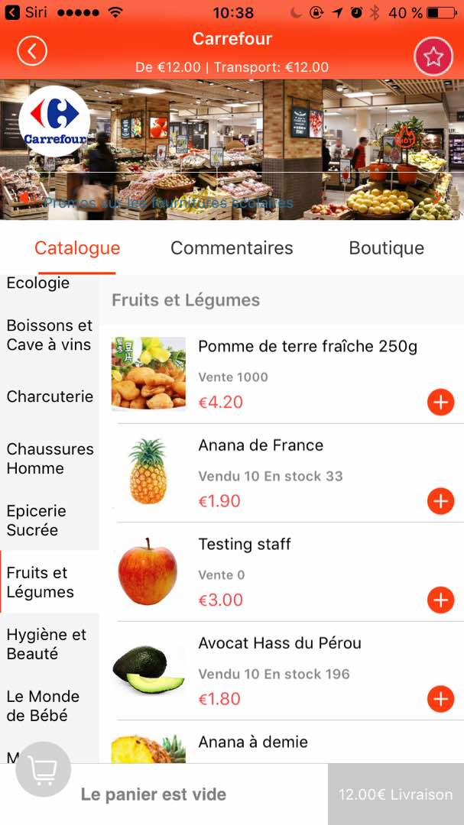
Screen 4
MENUS 1
MENUS 2
Or
MENUS 3
MENUS 4
MENUS 5
MENUS 6

Slide 22
Screen 4
Menu 1
Menu 2
Or
Menu 3
Menu 4
Menu 5
Menu 6

Slide 23
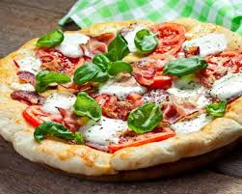

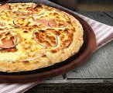
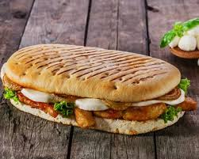
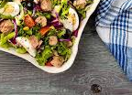

Screen 4
Or
Menus
Formules du midi
Pizzas crème fraîche
Paninis
Salades
Desserts

Slide 24
Store categories
(do not do)
Category: Category A
Category: Category B
Background can be : picture, gif or video
Minimum amount to get the delivery and the cost of delivery.
Example: delivery from 12.00 € and shipping cost: 12.00 €
MENUS 1
MENUS 2
MENUS 3
MENUS 4
Here when the user clicks, he adds the shop to his favorites
MENUS 5
MENUS 6
Back button to return to the previous screen

Slide 25
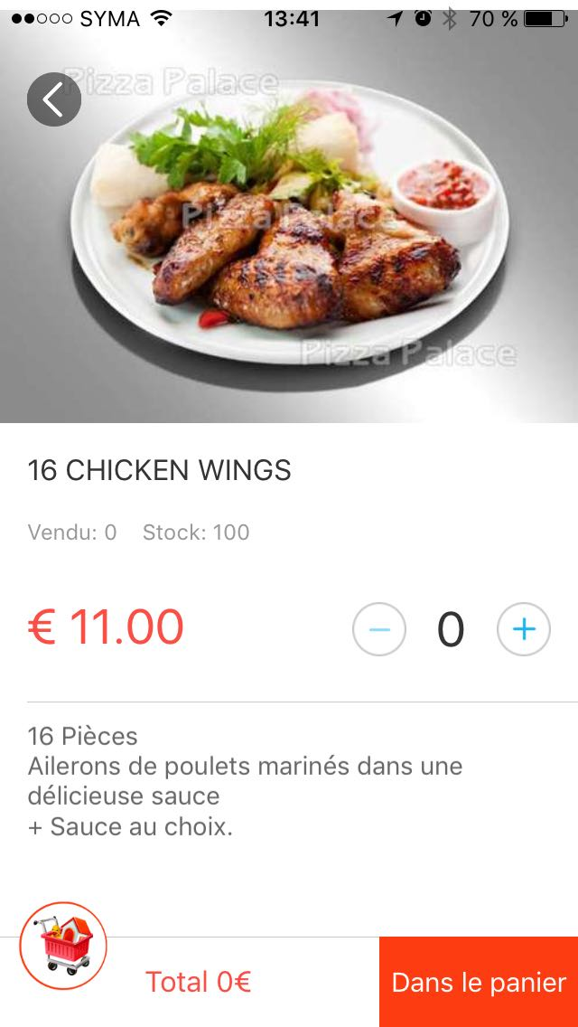
Store categories
Category: Category A
En savoir plus

Slide 26

Store categories
Catalogue Commentaires Boutique
Restabat ut Caesar post haec properaret accitus et abstergendae causa suspicionis sororem suam, eius uxorem, Constantius ad se tandem desideratam
spe tamen quod eum lenire poterit ut germanum profecta, cum Bithyniam introisset, in statione quae Caenos Gallicanos appellatur, absumpta est vi febrium repentina.
02 35 89 85 31

Slide 27
Screen for comments
- On the comments screen, you have to display the last 15 comments posted by the users.
- Attention: only users who have already bought once in the store can post comments.
These users can also edit / delete their comments.
- In the administration, store managers can not edit comments.
- Only the system administrator can disable / delete comments.
- The store manager can respond to comments.
Catalogue Commentaires Boutique
Catalogue Commentaires Boutique
Julien:Restabat ut Caesar post haec properaret accitus et abstergendae causa suspicionis.
Note : 4/5
Postez votre commentaire
Julien:Restabat ut Caesar post haec properaret accitus et abstergendae causa suspicionis.
Postez votre commentaire
Ecrivez votre commentaire
Marie:Restabat ut Caesar post haec properaret accitus et abstergendae causa suspicionis.
Adams:Restabat ut Caesar post haec properaret accitus et abstergendae causa suspicionis.

Slide 28
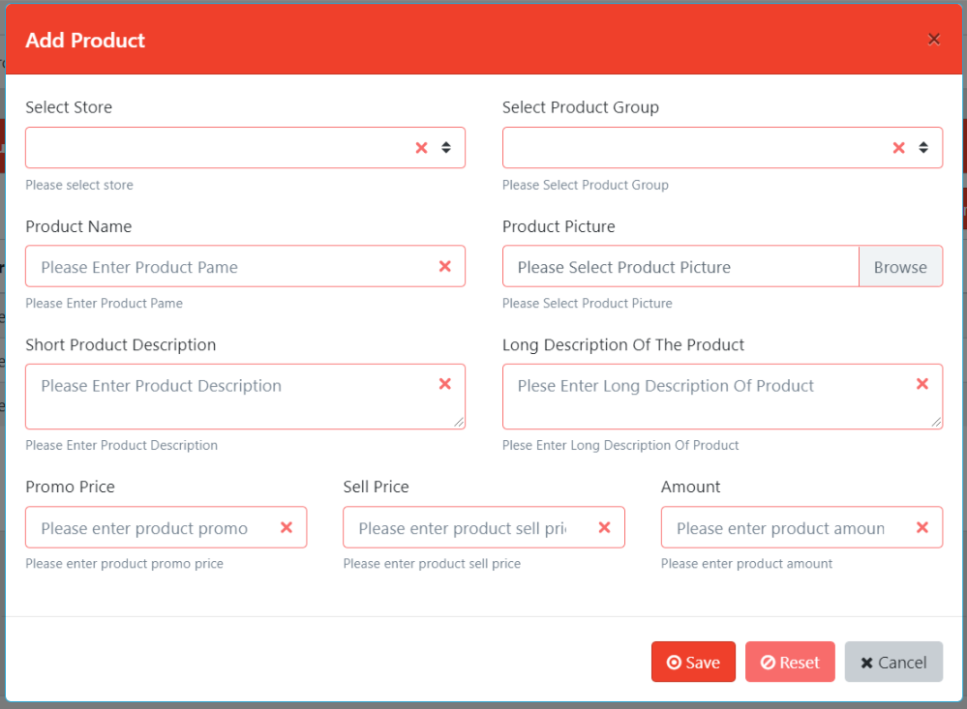

Store categories
Mexicaine
Calzone
Sauce tomate, mozzarella, oignon, merguez, viande hachée
Sauce tomate, mozzarella, oignon, merguez, viande hachée
En savoir plus
En savoir plus
Junior: 10,90€
Junior: 10,90€
Senior: 12,90€
Senior: 12,90€
Mega: 19,90€
Mega: 19,90€

Slide 29
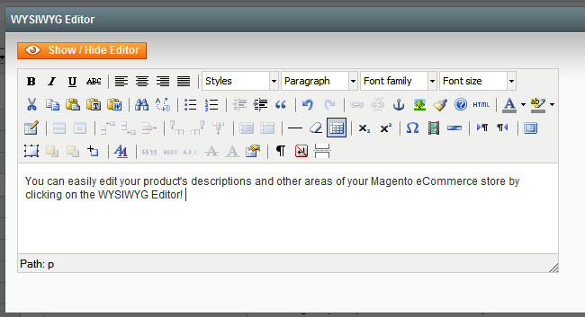
Store categories

Slide 30

Community Social Network

Slide 31
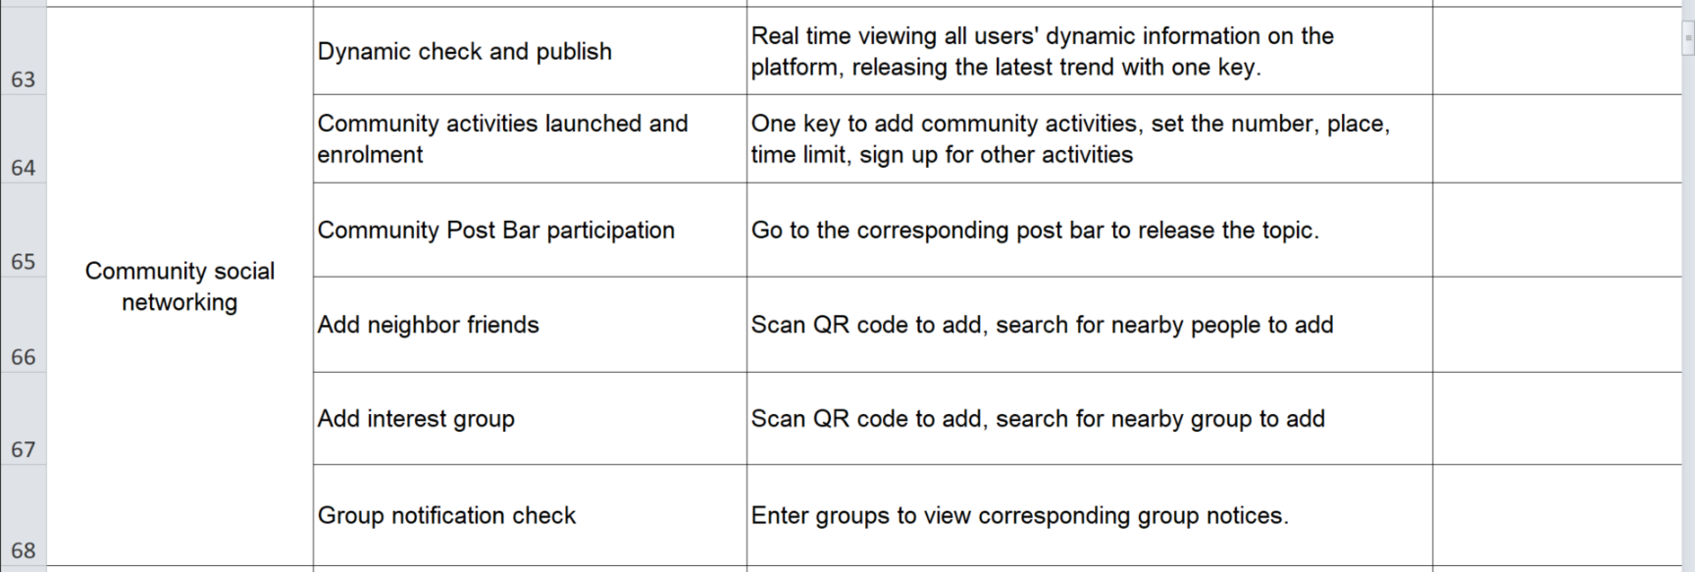
Specifications of Community Social Network
In chats between 2 users or in groups, there will be only exchanges of text messages and possibility of adding images. No audio and video messages for the moment

Slide 32
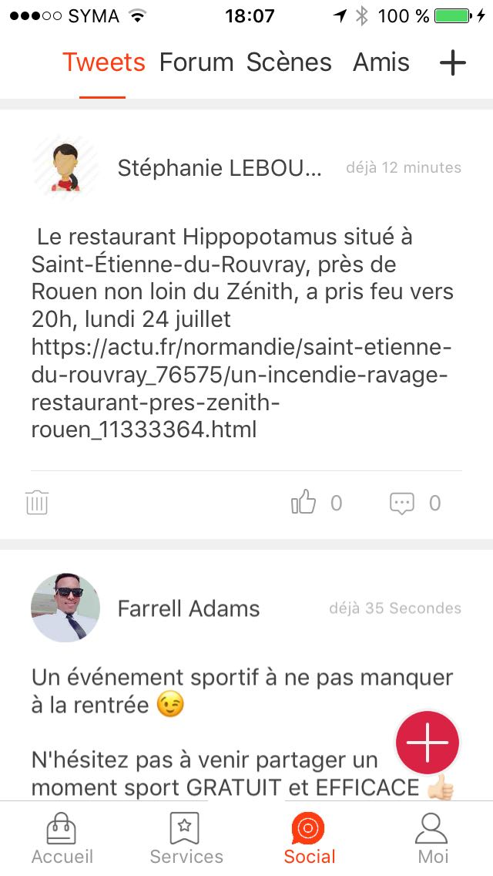
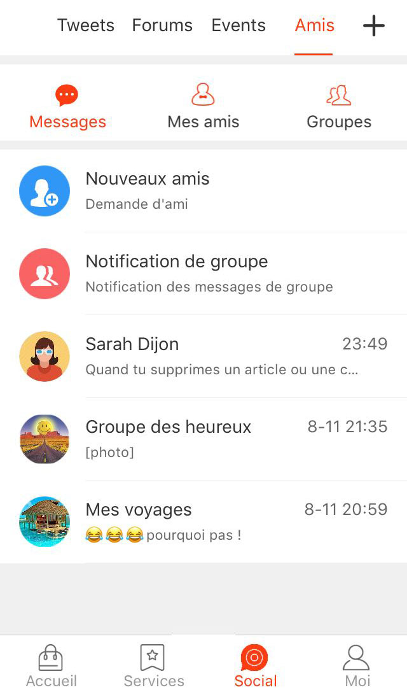
Screen of Community Social Network
Replace the word "Tweets" with "Posts"
Please put this + button to add a post.

Slide 33
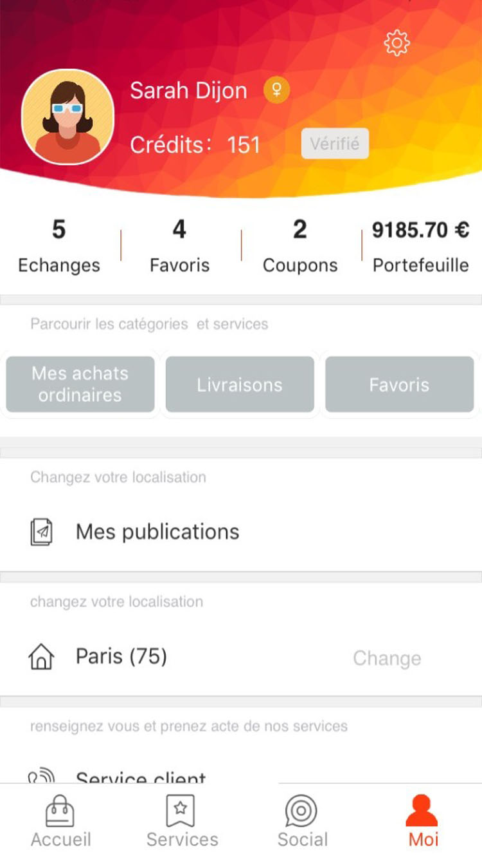
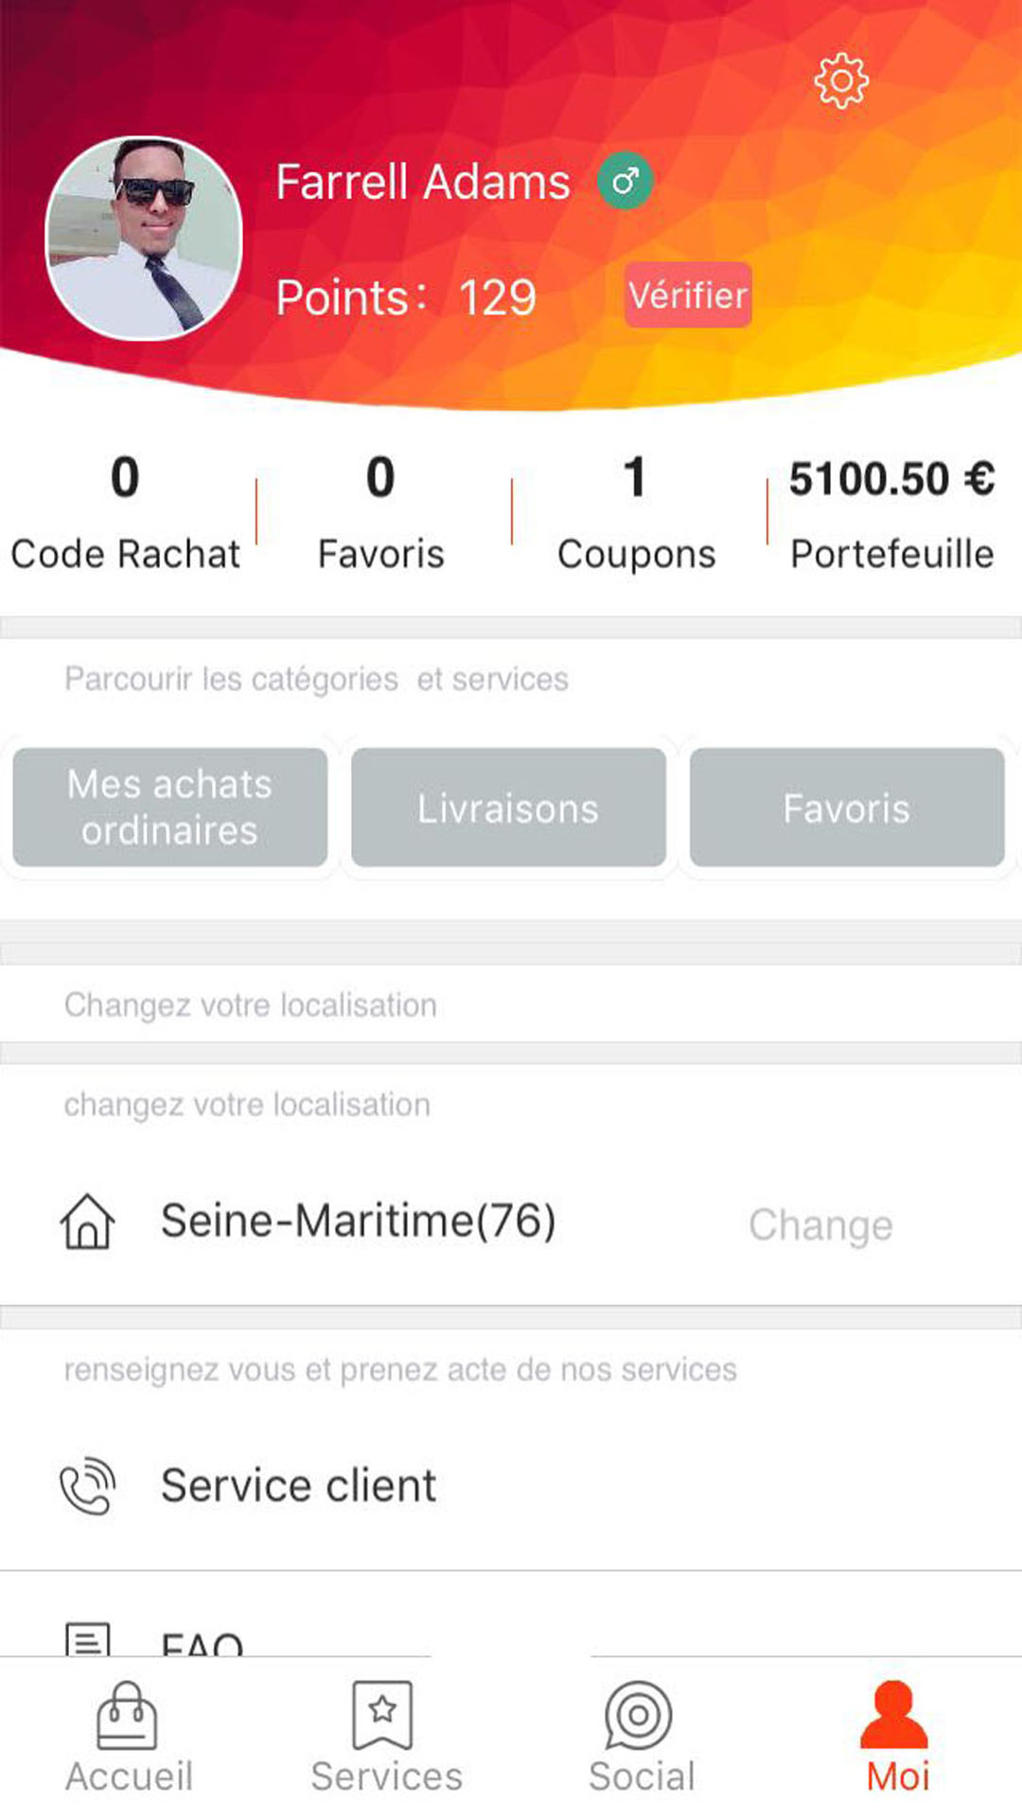
Screen 5
Personal Center
Please remove this part. The red band means you have to remove that part
Panier
Panier

Slide 34
Screen 5
Personal Center
It is a menu sliding horizontally
“Mes achats ordinaires” ===>By clicking on this button, the user accesses its list of purchased products.
“Panier” ===>user access to his cart and can see the products he has selected. From this basket he can validate his order
“Livraisons”==>List the deliveries:
- Deliveries in progress
- Past deliveries
“Favoris” ===> list of stores that user liked
“Bon coin” ===> List items that user post in “Ads between individuals”. Here the user can edit, delete his ads.
Panier

Slide 35
Screen 5
Personal Center
It is a menu sliding vertically.
“Mes publications” ===>List of tweets posted in social network. Here the user can edit, delete his tweets.
“Paris(75)===>indicates that the user is connected in the city of Paris. The user can click on "Change" to change the place of connection.
“Service client”===>Clicking on it will take you to a screen that displays the customer service phone number. And as a customer on this number, it triggers the call.
“Message au service client”===>By clicking on it you access a screen that displays the contact form containing only the message field with the possibility to add attachments.
“Conditions et politique de confidentialité”===> a link to a web page

Slide 36
Screen 5
Personal Center
User accesses his profile and can subsequently modify his profile
Do not put
Panier

Slide 37
Screen to see the profile
Profile
Statut: entrepreneur à succès
Nom: Farrell
Prénom: Adams
Date de naissance: 25/04/2001
Email: Farrell.adams@gmail.com
Tél: 06 58 89 85 31
Adresse: 17 rue de la République,
76190 - Yvetot
Modifier votre profil

Slide 38
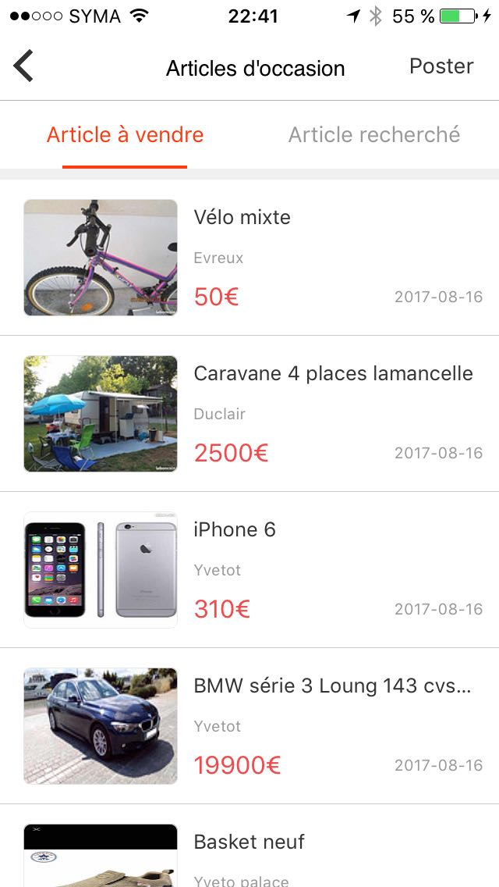
Ads between individuals
Users can post classifieds of sales between individuals.

Slide 39
Ads between individuals
Users can post classifieds of sales between individuals.
List of items that users have put on sale
List of items that users are searching for.
here user accesses the form to post his ad.
At the very beginning of the form, the user must choose whether to sell or search for an item.
Publication date of the ad

Slide 40
Ads between individuals
Vendre
Rechercher
Nom de l’article
Description de l’article
Prix de l’article
Adresse:
N° et nom de rue
Ville
Code postal
Ajouter des photos:
Poster

Slide 41


Ads between individuals
10 pictures that can be scrolled horizontally
Nom du produit
Description du produit
Prix du produit
Adresse du produit
Message
Appel

Slide 42
Jobbing

Slide 43
Jobs
Users can post jobs.
Jobs
Je propose
Je cherche

Slide 44
To create a Job on mobile app
Je propose
Je cherche
Titre de l’annonce
Jobs
Description de l’annonce
Je propose
Je cherche
Catégorie
Prix
Adresse:
N° et nom de rue
Ville
Code postal
Ajouter des photos:
Poster

Slide 45
Display a Job
10 pictures that can be scrolled horizontally
Titre de l’annonce
Je propose
Je cherche
Description l’annonce
Prix
Adresse du produit
Postulez à cette annonce
Envoyez un message pour postuler
Joindre un CV:
Je postule

Slide 46


Screen Coin’aff
When we click on the icon Coin'aff, we reach this screen:
Petites annonces entre particuliers
Je trouve un job

Slide 47
Admin panel

Slide 48
Admin panel
Admin panel is a web interface.
Admin panel contains 2 accounts:
- Admin
- Manager(all stores)
- Store manager
I would like a very basic admin!

Slide 49
Admin panel
Admin panel is a web interface.
Admin panel contains 3 accounts:
- Super-administrator
- Administrator
- Trader
I would like a very basic admin!

Slide 50
Admin panel
Roles:
Admin | Administrator | Trader
- Create/Disable/delete stores. - Add / edit / delete products in stores. - See the list of orders in the different stores - Manage advertising products on the screen 1 - Moderate (Add / Edit / Delete) posts in the social network community as well as in ads - Delete/Desactivate a user - Create/Disable/delete “administrator” and “trader” | - Add / edit / delete products in stores. - Moderate (Add / Edit / Delete) posts in the social network community as well as in ads | Add / edit / delete products in his store. This user only sees his store, he can not manage the store. He manages that his shop to him.

Slide 51
Admin panel
Roles:
Super-administrator | Manager(all store) | Store Manager(trader)
- Create/Disable/delete stores. - Add / edit / delete products in stores. - See the list of orders in the different stores - Manage advertising products on the screen 1 - Moderate (Add / Edit / Delete) posts in the social network community as well as in ads - Delete/Desactivate a user - - Create/Disable/delete “manager” and “store manager” | - Add / edit / delete products in stores. - Moderate (Add / Edit / Delete) posts in the social network community as well as in ads | Add / edit / delete products in his store. This user only sees his store, he can not manage the store. He manages that his shop to him.

Slide 52
Store management
Accueil | Ajouter un magasin | Ajouter un groupe de produits | Ajouter un produit à A | Ajouter un produit à B
Ajouter un magasin
Nom
Téléchargez le logo
Téléchargez la photo/gif/video de couverture
Description
Numéro de téléphone
Adresse principale
Nom de la rue
Code postal
Ville
Autres adresses
Nom de la rue
Code postal
Ville
+Autre adresse

Slide 53
Store management
Accueil | Ajouter un magasin | Ajouter un groupe de produits | Ajouter un produit à A | Ajouter un produit à B
Catégories magasins
Types de produits
Habillement/mode
Beauté/santé
Produits culturels
Maison, décoration
Voyages/tourisme
Articles, matériels de sport
Jeux, jouets
Bio
Chaussures
Produits techniques/électroménager
Prix de la livraison
Minimum pour la livraison
Ajouter le magasin

Slide 54
Store management
Accueil | Ajouter un magasin | Ajouter un groupe de produits | Ajouter un produit à A | Ajouter un produit à B
Ajouter un groupe de produits
Sélectionner le magasin
Nom du groupe
Télécharger la photo d’illustration du groupe
Ajouter le groupe

Slide 55
Store management
Accueil | Ajouter un magasin | Ajouter un groupe de produits | Ajouter un produit à A | Ajouter un produit à B
Ajouter un produit dans magasin de catégorie A
Sélectionner le magasin
Sélectionner le groupe de produits
Nom du produit
Description courte du produit
Description longue du produit
Prix promo
Prix vente
Quantité
Ajouter le produit

Slide 56
Store management
Accueil | Ajouter un magasin | Ajouter un groupe | Ajouter un produit à B | Ajouter un produit à B
Ajouter un produit dans magasin de catégorie B
Sélectionner le magasin
Sélectionner le groupe de produits
Nom du produit
Description courte du produit
Description longue du produit
Type de produit/prix
Type
Prix promo
Prix vente
Quantité
Ajouter le produit
+Autre type

